Slide 1
Let’s begin your MRI journey!
Mathieu NAUDIN
Mathieu.naudin@chu-poitiers.fr
CHU Poitiers
LabCom CNRS I3M
DACTIM-MIS, Laboratoire Mathématiques et Applications CNRS 7348, Université de Poitiers

Slide 2
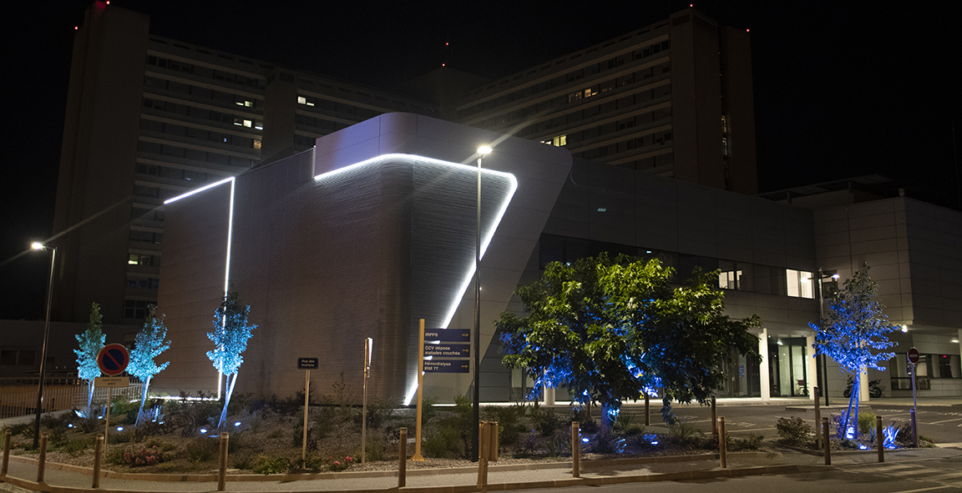
Who I am?
PhD thesis at Siemens Healthineers (2015-2018)
XLIM as main research center
Collaboration with LMA and CHU de Poitiers
Research engineer at CHU Poitiers
Responsible of 7 Tesla magnet engineering
Responsible of AI platform of I3M lab
Thanks to MR physicist Carole Guillevin and MR AI engineer Pierre Fayolle for their help
(and some of their slide for this course)

Slide 3
Course overview
Generalities in health domain : data format
MRI principle
Preprocess MRI data

Slide 4
Global objective of the class
Globally understand the MRI principle and the associated technology
Be able to work with medical MR data/imaging

Slide 5
Objectives of today’s class
Overview of MR technology and communication (DICOM)
A brief introduction to MR physics
Work with real MR data and associated k-Space

Slide 6
Exchange time!
What do you know about medical imaging ?

Slide 7
Introduction
Welcome in the medical image jungle!

Slide 8
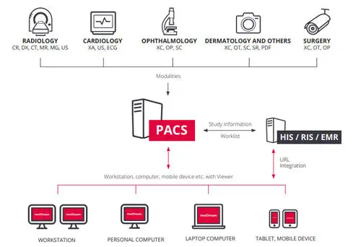
Introduction
Typical Architecture of an imaging structure private or public

Slide 9
Introduction
Have a closer look to the previous items:
- RIS : Radiology Information System for the patient/appointement/ data management
- PACS : stands for Picture Archiving and Communication System, this is the location where images are stored(DB)

Slide 10
Introduction
- Scanner/Sources : A large number of sources can generate images. They can be original or secondary (captures, documents, AI results, etc)
- Users : a large number of people are inside these systems : radiologists, technologists, clinicians, etc.
⇒ Simpliest example !

Slide 11
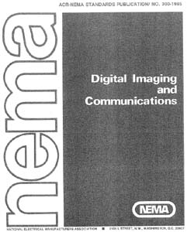
DICOM
This is the Universal format of medical imaging
Old one: 1985
Proposed by :
ACR : American College Of Radiology
NEMA : National Electric Manufacturers Associations
It is not only an imaging format :
Communication protocole TCP/IP
Images format
Increase the inter-constructor operability by a format thant can be adopted by everyone

Slide 12

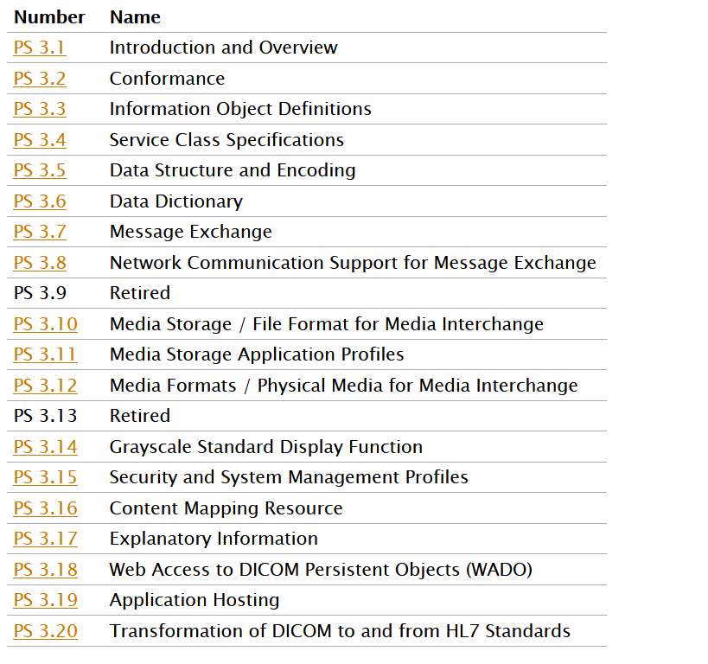
DICOM
Now, in its third version from … 1993
Adding several items along the years : version 3
Small evolution are added every years, no version 4 planned for the moment

Slide 13
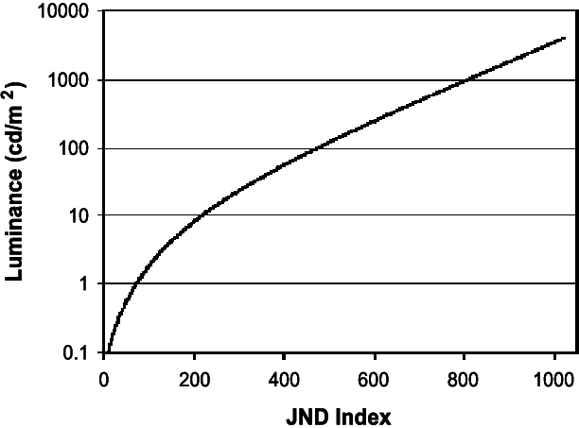
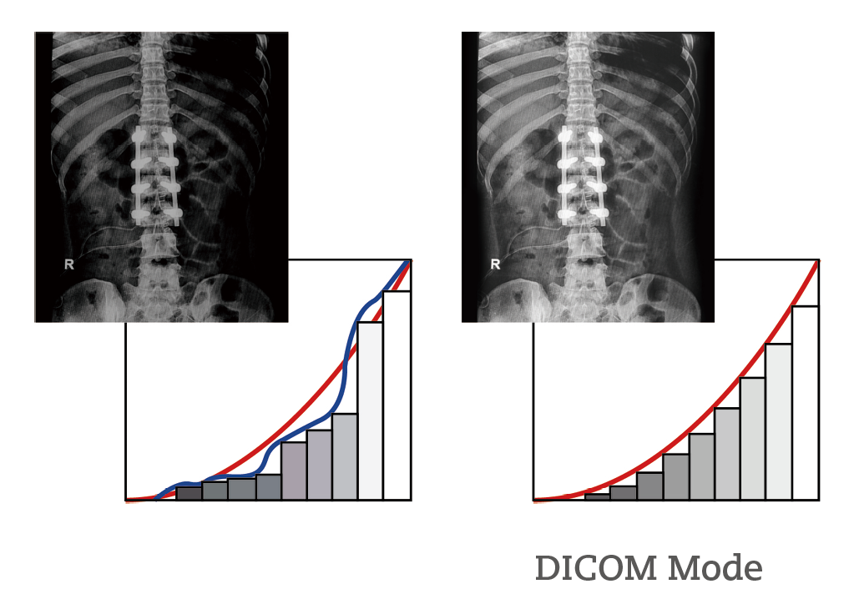
DICOM
it is also a display format for medical data.
It appears in the form of a Looking Up table (LUT) thanks to the DICOM Grayscale Standard Display Function (GSDF) function.
Specific charts are used for calibration and screen verification.
Barten’s Curve

Slide 14

DICOM
Format is now HUGE
22 parts
More than 3500 tags referenced
Didn’t take into account the private tags from constructors
Complex drift requiring a good understanding of the structure

Slide 15
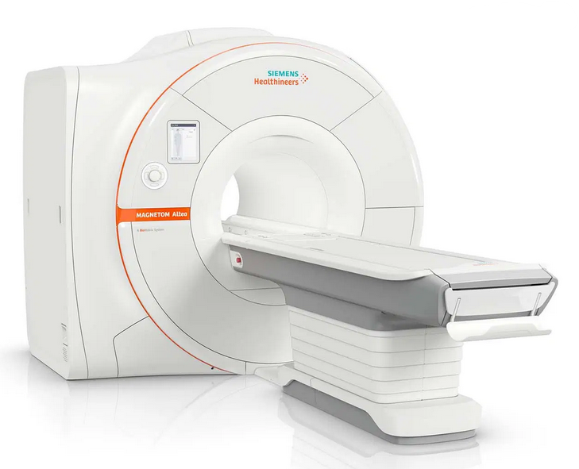
DICOM Objects
CR
CT
MR
NM
SC
US
US multi
XA
XA bi
XRF
Computed Radiography Imaging
Computed Tomography Imaging
Magnetic Resonance Imaging
Nuclear Medicine Imaging
Secondary Capture Imaging
Ultrasound
Ultrasound Multi-fame Imaging
Angiographic Imaging
X-Ray Angiographic Bi-Plane Imaging
X-Ray Radiofluoroscopic Imaging

Slide 16
DICOM Services Classes
1. Verification
2. Modality Worklist Management
3. Performed Procedure Step [PPS]
4. Store
5. Storage Commit
6. Print
7. Query/Retrieve

Slide 17
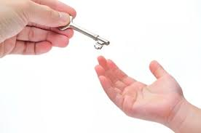
Storage and Storage Commit
Both are transfering images
But, in the commitment, the ownership is transferred and the image could be safely deleted from the Object

Slide 18
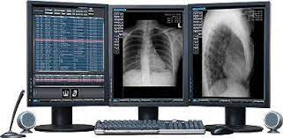
SCU and SCP
MR Image Storage SOP Class
SCU
Service Class user
Client
SCP
Service Class Provider
Server
SOP
Service Object Pair

Slide 19
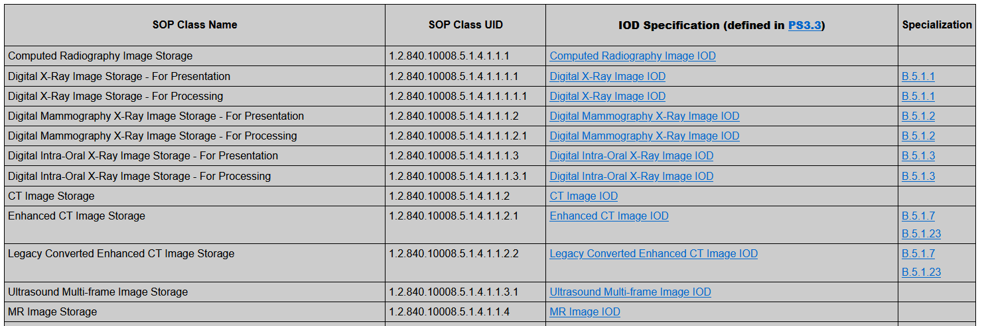
SOP

Slide 20
Machine negociation
FOR EACH dicom file generated
<Request>
<Response>
MR Image Store SOP Class
AE_T 2
AE_T 1

Slide 21
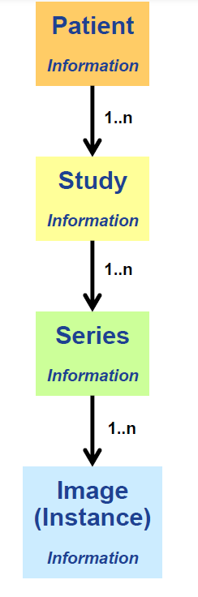
Information model
Divided into several subparts
A Patient
Several Study
Divided into several series
That contains several instances
Study
Asked as initial protocol
Series
MRI sequences done by the technologist

Slide 22

Mandatory UID
SOP Class UID Identify : the service type/object to the storage location
Study Instance UID : Identify a full examination (location and time)
Series Instance UID : Identify a image series from study
SOP Instance UID : Identify image associated to the file

Slide 23
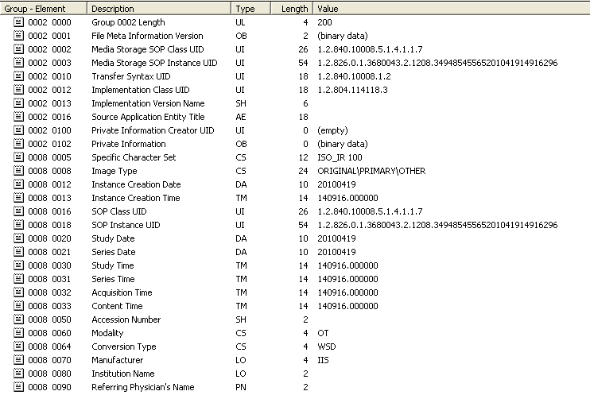
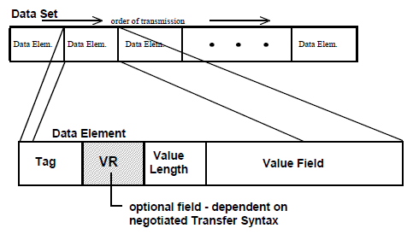
DICOM

Slide 24

DICOM
But … where is the image in this jungle ?
It is hidded in the Pixel Data Tag
Tags needed to fully use the pixel data :
Rows and Columns
Samples Per Pixel
Photometric Interpratation
Planar configuration
Bits Allocated, Bits Stored and High Bit
Image size computing:
ROWS * COLUMNS * NUMBER_OF_FRAMES *
SAMPLES_PER_PIXEL * (BITS_ALLOCATED/8)

Slide 25

NIFTI
Neuroimaging Informatics Technology Initiative
This is a neuroimaging format that is still in its early stages.
Unlike DICOM, it uses a single file to group files.
NIFTI is available in two versions - NIFTI-1 and NIFTI-2 - which allow for superior storage.
Additionally, there is a difference in reference between DICOM and NIFTI

Slide 26
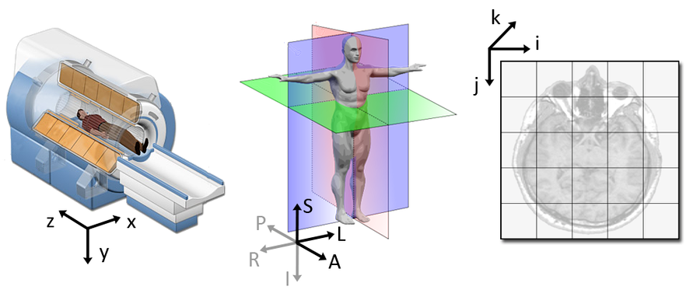
NIFTI
With two mains differences: LPS (DICOM) et RAS (NIFTI)

Slide 27
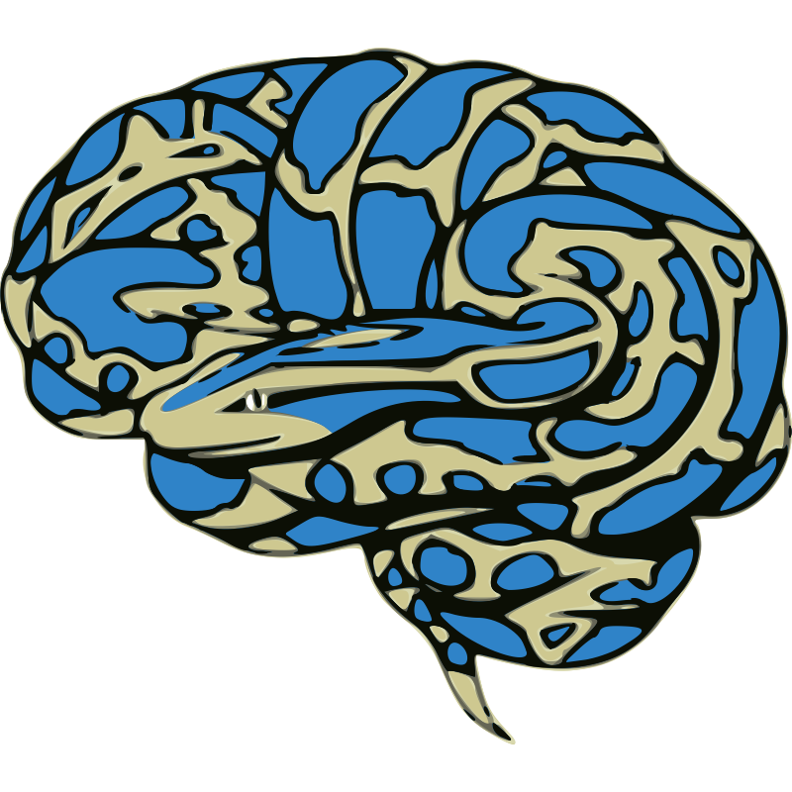
NIFTI
Composed by a simple header (less complex than the DICOM)
Then, a data matrix (with all slices)
Contains also transformation matrix
Useful Python library: Nibabel

Slide 28
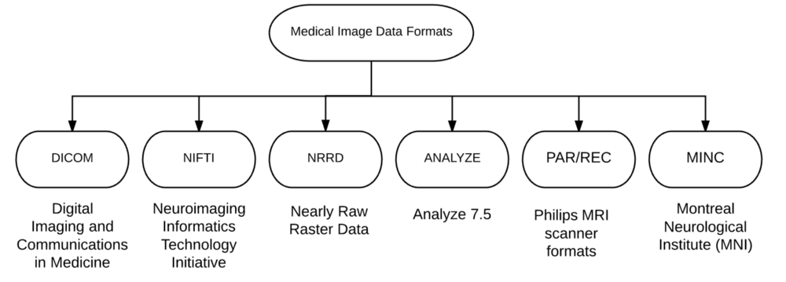
Other formats

Slide 29

Other formats
.hdr / .img / .rda / .npy
There is a large, large number of different medical imaging format
Advice : Try to come back as possible to something you know
Helps in using well known tools (software, etc.)
Re-use that you coded before for this specific type
Will smooth the imaging transfert part
Don’t be lost in file format jungle

Slide 30
Quizz
To see if everything is ok!

Slide 31
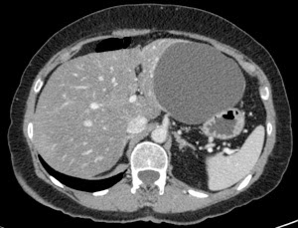
Question 1 : modality ?

Slide 32
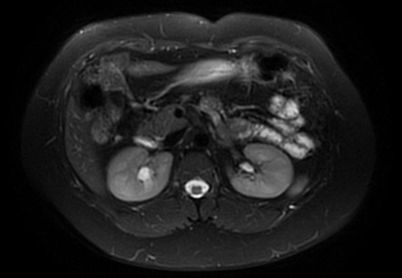
Question 2 : modality ?

Slide 33
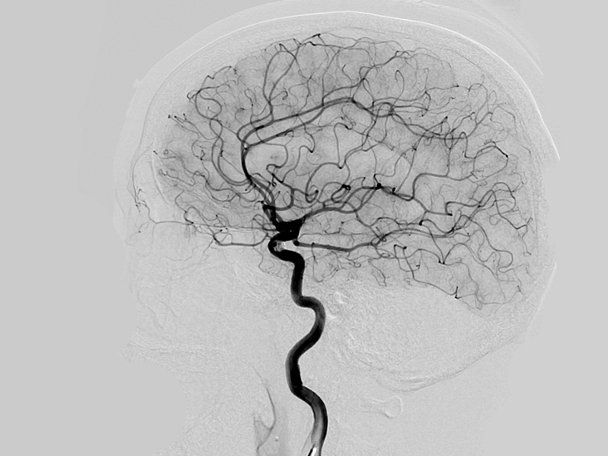
Question 3 : modality ?

Slide 34
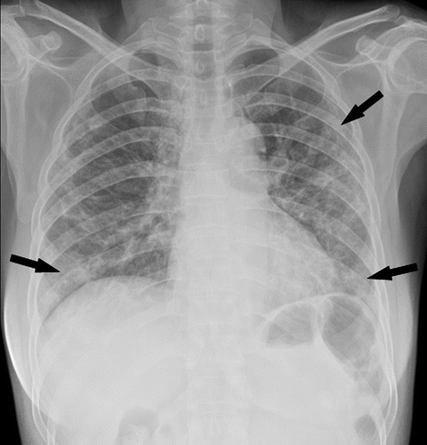
Question 4 : modality ? Pathology ?

Slide 35
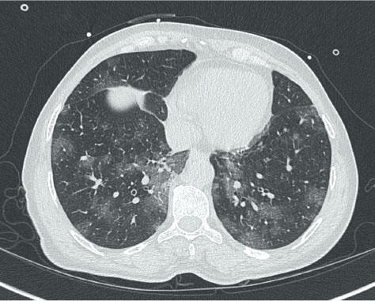
Question 5 : modality ? Pathology ?

Slide 36
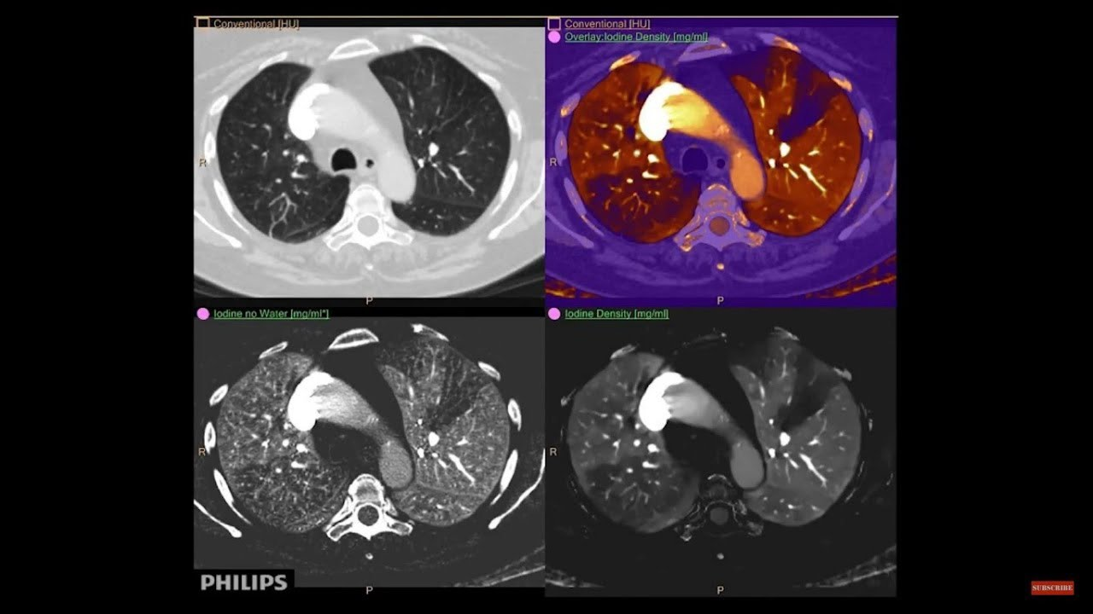
Question 6 : modality ?

Slide 37
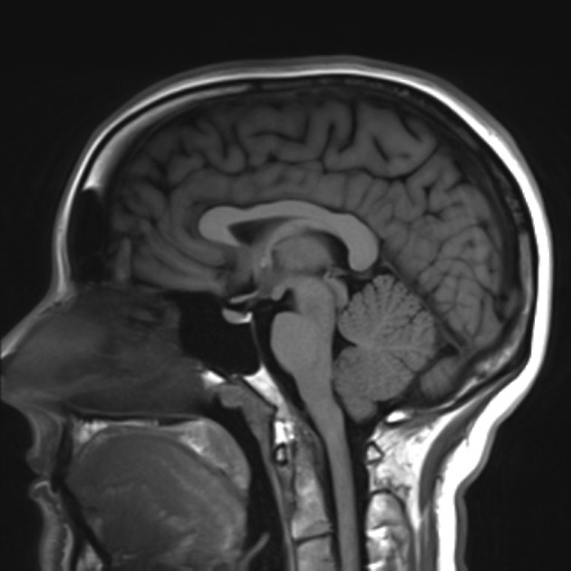
Question 7 : modality ? Ponderation ?

Slide 38
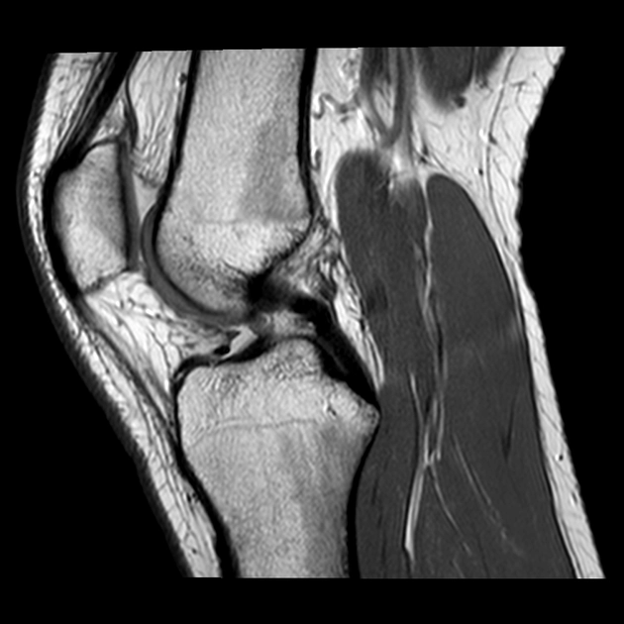
Question 8 : modality ? Ponderation ?

Slide 39
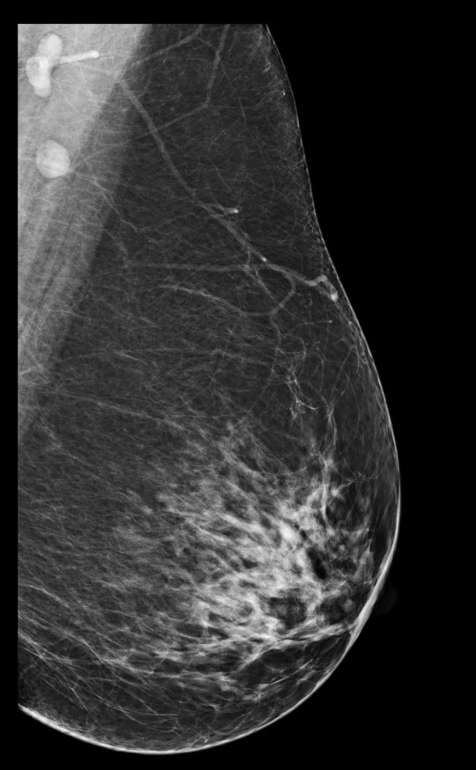
Question 9 : modality ? Ponderation ?

Slide 40
MR Generalities

Slide 41
Exchange time!
What do you know about MR ?

Slide 42
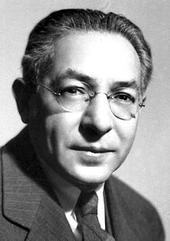
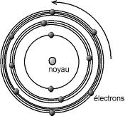
Historic
Starting from 1930, the physicist Isidor Isaac Rabi took an interest in the nature of the forces that bind protons in the atomic nucleus.
He pioneered molecular detection through a magnetic resonance system.
1933 Stern et al. discovered that the proton possesses a magnetic moment.

Slide 43
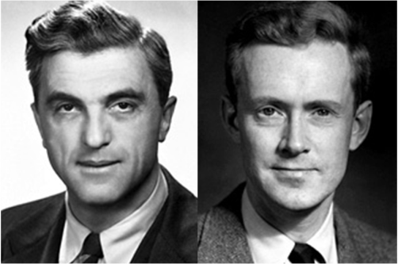
Historic
Magnetic field
In 1939, I. Rabi demonstrated the interaction of electromagnetic waves and nuclei on beams of atoms, discovering the phenomenon of magnetic resonance (Nobel Prize in Physics)
In 1946, the description of magnetic resonance imaging (MRI) on samples of water or paraffin was independently provided by F. Bloch (West Coast) and E. Purcell (East Coast).
The behavior of the proton in a magnetic field led to the Nobel Prize in Chemistry in 1952

Slide 44
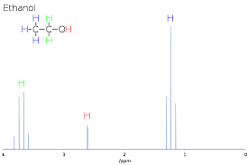
Historic
NMR Spectroscopy
1950-70
he phenomenon of magnetic resonance was first used by physicists and chemists to characterize matter through spectra..
Protor and Yu discovered the frequency shift depending on the molecular environment, turning NMR into an analytical chemistry tool.
Développement de la spectroscopie par RMN
NMR spectroscopy was further developed, with the first NMR signal recorded by Hahn, and the advent of superconducting magnets

Slide 45
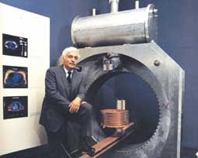
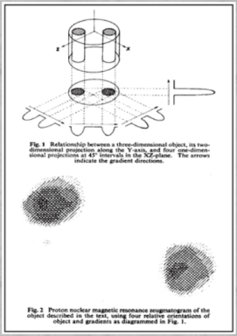
Historique
from Nature 1973; 242: 190- 191
MR Imaging
1971 Difference in NMR signal between normal and cancerous tissues: Robert Damadian
1972 Peter Mansfield developed mathematical formulas for faster MRI acquisitions
1973 Paul Lauterbur created a system capable of producing a virtual cross-sectional image of an object :
introducing gradients
producing the first images of two test tubes.

Slide 46
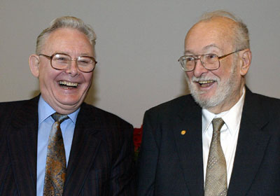
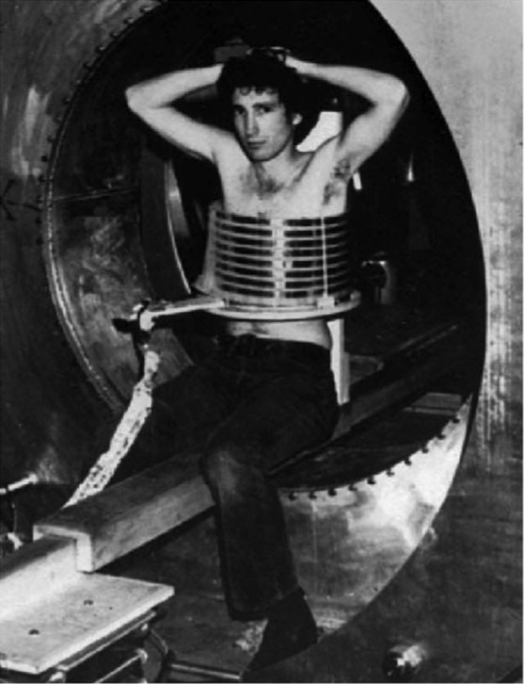
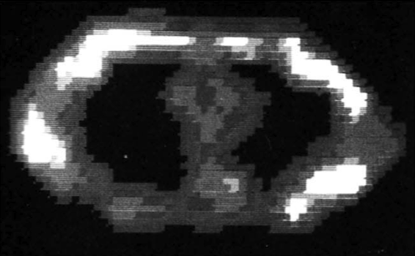
Historique
MR Imaging
1974 Paul Lauterbur (USA) and Peter Mansfield (GB) obtained the first images of a living animal by MRI (Nobel Prize in Physics in 2003)
1977 Premières images RMN humaines : Moor, Hinsaw-Mansfield
C'est à partir de ce moment que l'idée d'introduire la RMN en tant qu'imagerie médicale naît.

Slide 47
MR components

Slide 48
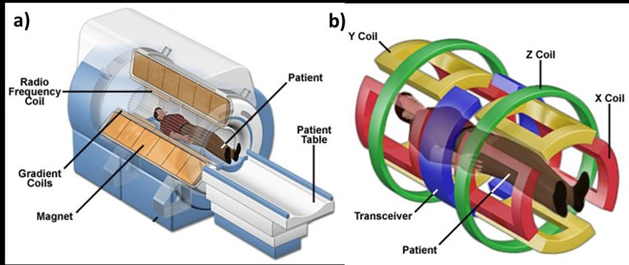
MRI machine

Slide 49
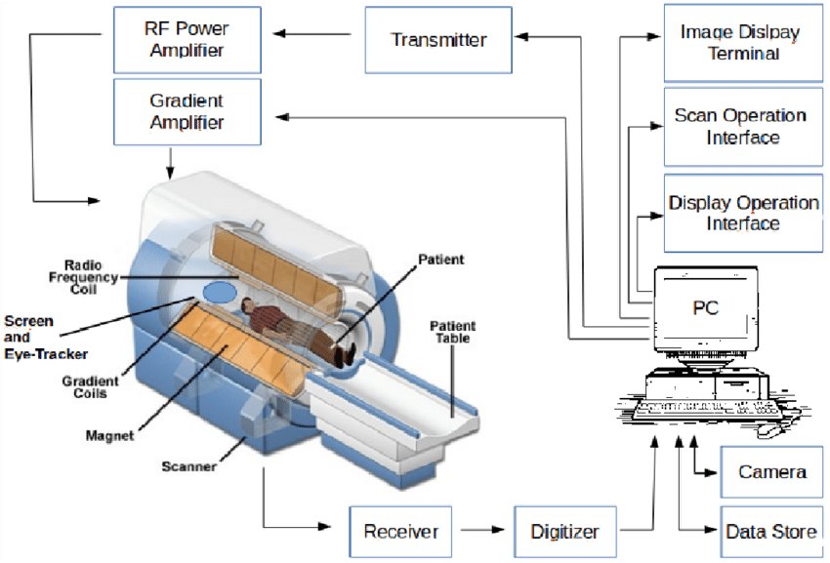
MRI machine

Slide 50
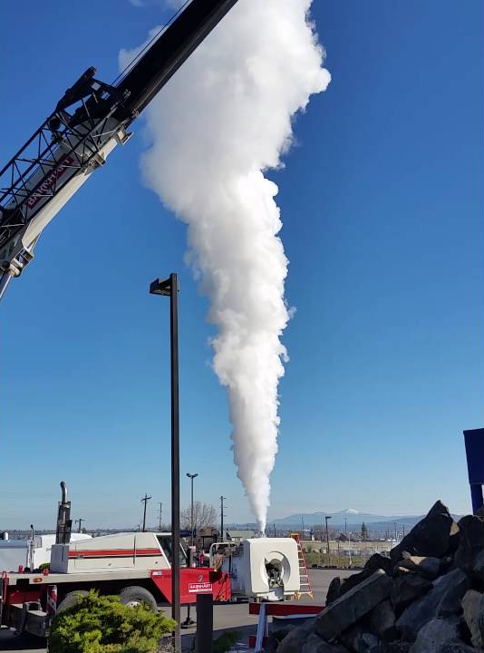
Quench of a MRI magnet
Quench = Sudden transition from liquid helium to gaseous state due to its heating due to malfunction of the thermal insulation system or caused by the safety punch.
It leads to a loss of superconductivity and therefore of the main magnetic field.

Slide 51
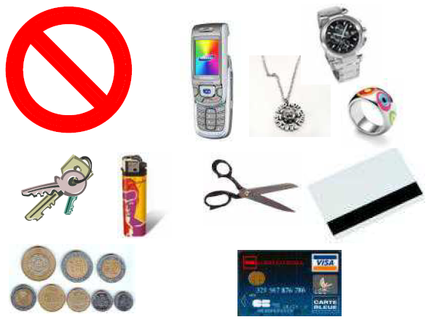
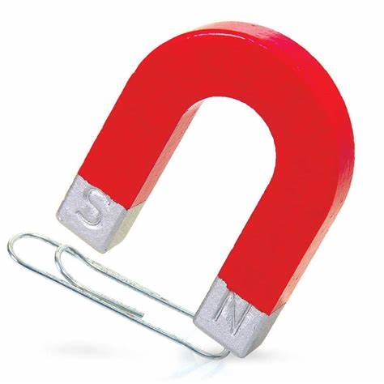
Magnet = strong magnetic field!
Attention to ferromagnetic objects!
DANGER for people with pacemarkers, metal implants

Slide 52
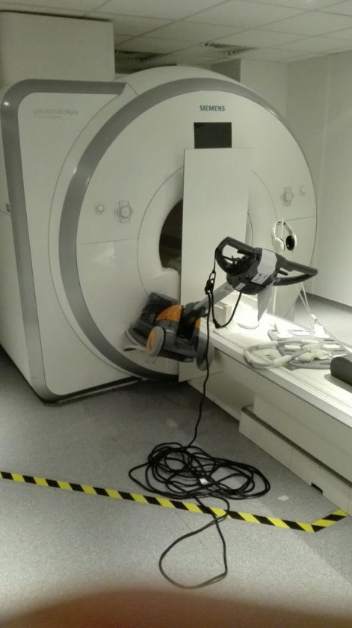
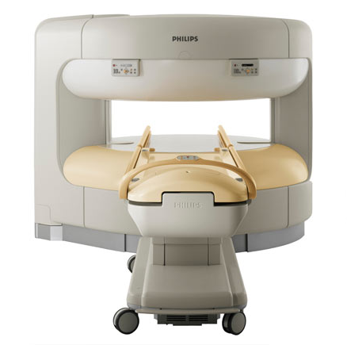
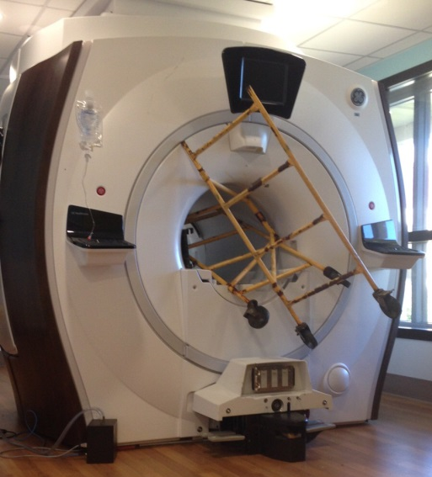
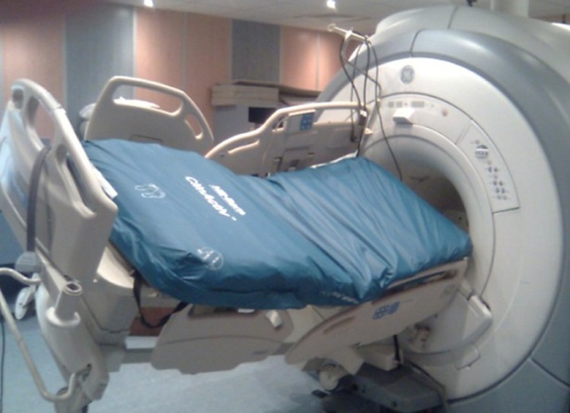
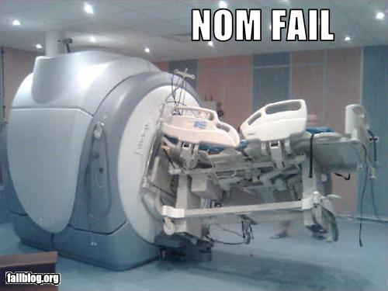
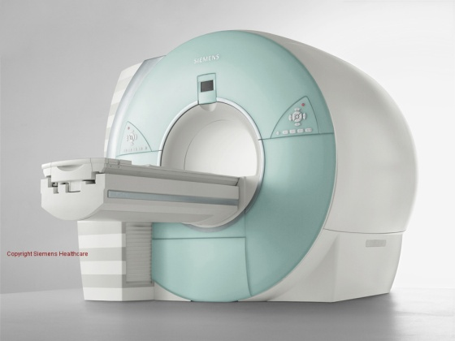
Magnet
Bo
Bo

Slide 53
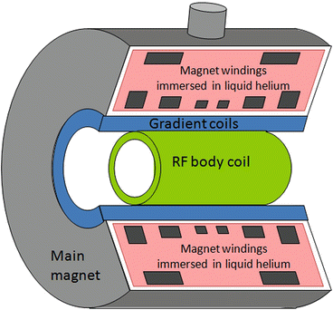
RF system
The RF system is made up of:
One or more RF generators.
Homogeneous RF antennas for excitation.
Sensitive RF antennas for signal reception.
Pre-amplifiers and amplifiers.
Analog-to-digital converters.

Slide 54
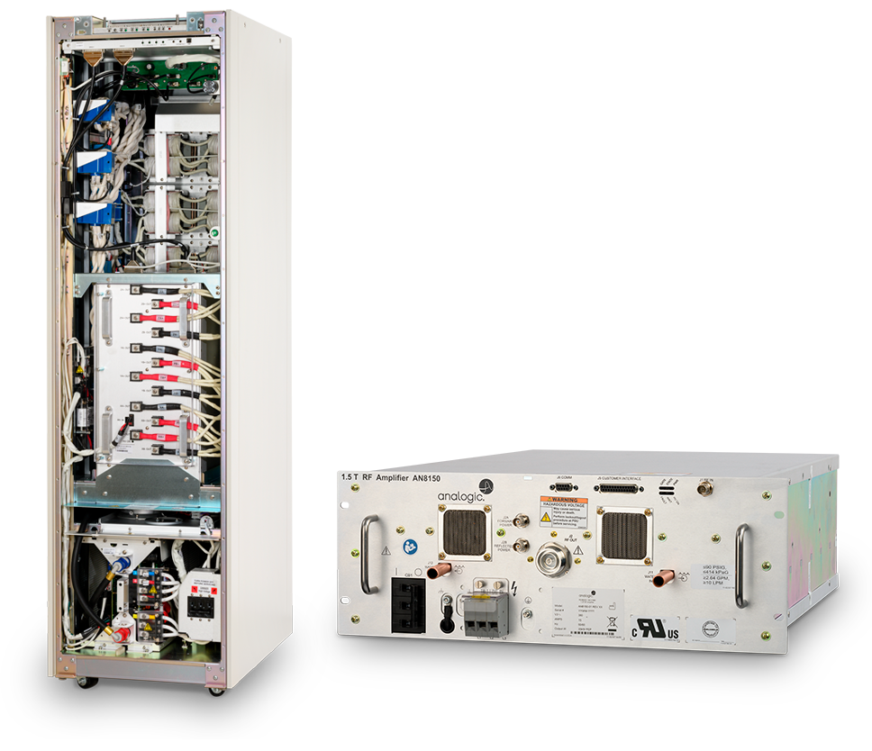
RF generator
The RF generator produces current pulses of variable shape oscillating around the resonance frequency.
Risks associated with RF:
RF energy absorption in tissues can produce local heating.
SAR (Specific Absorption Rate) = power deposited relative to the patient's weight
SAR < 10 W/kg for the whole body
SAR < 1.5 W/kg for the head

Slide 55
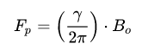
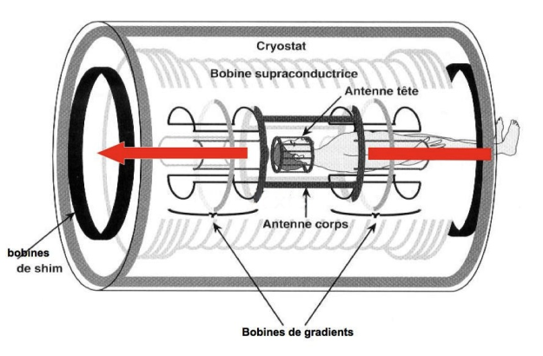
RF antennas
Antenna = resonant RLC circuit
Copper coil in different shapes
Tuned to the proton resonance frequency and impedance-matched to electronic circuits
Antenna tailored to the sample size to increase the signal-to-noise ratio (S/N)
Antennas are only receivers
The RF transmission is done by the integrated antenna between the machine chassis and the magnet

Slide 56
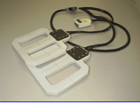


Coils
Surface coils
Surface coils are applied as close as possible to the regions being imaged.
Surface coils favor a high signal-to-noise ratio.
Volumic coils
Volume coils can encompass a region of the body (e.g. head, knee) or the entire body (whole-body coil).
Volume coils allow for a homogeneous signal across the entire imaged volume..

Slide 57

Gradient
The gradient system consists of
High-performance current generator.
Coils generating gradients in the three directions.
Coils for correcting gradient linearity.
A vibration-damping resin mold (for acoustic noise reduction).
A cooling water circuit.

Slide 58


Gradient coil

Slide 59
Gradient - Caraxteristics
The performance of gradients for spatial encoding of the signal is related to:
Their maximum amplitude (variation of magnetic field in mT/m), which determines the maximum spatial resolution (slice thickness and field of view).
Their slope, which corresponds to their switching speed. A high slope is necessary to quickly switch the gradients and enable ultra-fast imaging sequences.
Their linearity, which must be as perfect as possible within the field of view.

Slide 60

Les gradients - Caractéristiques
Eddy currents
During the rise and fall of gradients, induced currents can be created in conductive materials near the gradient coils (cryogenic envelope, electrical wires, antennas, shimming coils...).
These induced currents (eddy currents) will oppose the gradient field and degrade their profile.

Slide 61

Gradients - Caracteristics
To counteract these induced currents, several methods are employed:
Active shielding of gradient coils.
Optimization of the profile of the electric current sent to the gradient coils during the rise and fall to compensate for eddy currents.
Gradient switching generates Lorentz forces that cause vibrations in the gradient coils and their supports.
These vibrations are the main source of the characteristic noise of MRI.

Slide 62

Gradient – level : clinic

Slide 63

Gradients – Level : expert

Slide 64
MR Signal

Slide 65

Spin
Spin is a fundamental property of particles, such as protons, that have a magnetic moment. It refers to the intrinsic angular momentum of the particle and can be thought of as its intrinsic spin.
Larmor frequency is the resonant frequency at which particles with a magnetic moment precess in a magnetic field. It is proportional to the strength of the magnetic field and the gyromagnetic ratio of the particle.
P+
n°
I

Slide 66
Les noyaux utilisables en RMN
Nuclei Nmber I Natural abundance. Sensibility Larmor frequency
% (MHz/T)
H1 ½ 99.98 1 42.576
H2 1 0.015 0.0096 6.535
P31 ½ 100 0.0664 17.236
F19 ½ 100 0.834 40.055
C13 ½ 1.108 0.0159 10.705
N15 ½ 0.365 0.00104 4.315
O17 5/2 0.037 0.0291 5.772

Slide 67




Le noyau d’hydrogène
In the human body, 75% is water.
2 hydrogen atoms per water molecule.
Hydrogen atoms represent 2/3 of the atoms in the body.
The hydrogen atom has a single proton with a very high magnetic moment.
In NMR, the nomenclature used is spins and protons.

Slide 68
Le phénomène RMN peut être décomposé en 3 étapes
1- Polarization
2- Resonance
3- Relaxation
NMR: studying the magnetization changes of the nuclei of a substance under the joint action of two magnetic fields:
A fixed and high static magnetic field Bo:
Equilibrium state.
A rotating electromagnetic field B1:
Perturbation state.

Slide 69


Polarization
It occurs during the introduction of the patient into the B0 magnetic field.
Natural environment
B0 magnetic field
Notes:
Pour un vecteur individuel dans Bo, création d’un moment magnétique u = gamma *spin.
Moment cinétique peut etre quantifié C = gamma * Bo -> moment magnétique quantifié alors le vecteur peut prendre que certaines directions ( parallèles et antiparallèles à Bo)
Les vecteurs aimantations microscopiques adoptent un mouvement de précession autour de Bo w= gamma Bo
Pour une population de vecteur

Slide 70

Polarization
To be more precise, the spins are distributed on a cone of axis B0, with an excess of spins oriented parallel to B0 (Boltzmann distribution).
This induces the appearance of a macroscopic magnetization vector M0 parallel to B0: the longitudinal component Mz0.
M0 corresponds to the vector sum of all the spins.
Mz0 increases as the magnetic field B0 increases.
Spins are dephased.
+1/2
B0
Mz0
Parallel
-1/2
Anti Parallel

Slide 71
ResoNance
z
!!! Equilibrium state: Impossibility to measure Mz !!!
No signal.
Mz
B1
B0
Perturbation is inducted by energy !
y
x

Slide 72

ResoNance
Emmiting antenna
Antenna = resonant circuit (R, L, C)
B1 field delivered by the antenna perpendicular to Bo.
Tuned to the resonance frequency of the proton. Impedance matching to the electrical circuits.

Slide 73


ResoNance
Disturbance of the equilibrium state
B0
α = γ.B1.τ
Emitting coil
Mo
B1
M
τ
The macroscopic magnetization M rotates by an angle α proportional:
To the amplitude of the emitted B1 field
To the duration of the emission τ.

Slide 74

Relaxation
Relaxation characterizes the return to equilibrium of the spin system.
It begins when the RF wave B1 stops => exchange of energy with the environment.
B0
½ ΔE
ΔE
-1/2 ΔE
Mxy

Slide 75

Longitudinal relaxation – T1
When B1 stops, two phenomena occur:
Longitudinal relaxation characterizes the return of magnetization along Bo.
Return of an excess of protons in the parallel direction to Bo.
It is define by the longitudinal relaxation : T1
Mz = Mo [1-exp (-t/T1)]
Mz
Mo
Temps t

Slide 76

Longitudinal relaxation – T1
T1 is long and specific to each tissue and not constant over time
The T1 of a tissue is the time it takes for it to achieve 63% of its T1 relaxation.
T1 depends on the properties of hydrogen nuclei contained in different tissues.
T1 varies depending on the tissues.

Slide 77

Transversal relaxation - T2
When B1 stops, two phenomena occur:
The longitudinal relaxation characterizes the recovery of the magnetization along the z-axis.
The transverse relaxation characterizes the decay of transverse magnetization.
Redephasement of spins relative to each other occurs during transverse relaxation.
It’s define by the T2 relaxatoon time
Mxy = Mo exp (-t/T2)
Mxy
Mo
Temps t

Slide 78

Transversal relaxation - T2
Fast, tissue-specific, and not constant over time.
The T2 of tissue is the time at which the tissue has undergone 63% of its T2 relaxation. This means that 37% of the transverse component remains.
T2 depends on the interactions between hydrogen nuclei in different tissues, and varies depending on the tissue type

Slide 79
Transversal relaxation - T2*
If there are field inhomogeneities in the sample, spins will not precess at the same frequency f0
An additional phase shift is required to obtain the true T2, using a 180° pulse.
The decay of transverse magnetization is then faster: T2*.
Mxy
Mo
T2
T2*
Temps t

Slide 80

Signal reading
The FID decreases like T2, but in reality it decreases more rapidly due to field inhomogeneities.
Signal
B0
S0
T2 ou T2*
Temps
The collected signal S is a Free Induction Decay (FID)
S = So sin (2π.fo.t) exp(-t/T2)
Oscillations à la fréquence fo
Relaxation transverse

Slide 81

Imperfect magnetic field + current in the shim coils
B0 non homogeneous
Result : FID longer more T2 than T2*
B0 homogeneous

Slide 82
Signal to image

Slide 83



Gradients
To form an image, it is necessary to localize in space the signal received by the antenna.
This is possible thanks to the use of magnetic field gradients applied in the three planes of space at different times during the sequence.

Slide 84





3D encoding
Tac = TR ∙ NPy ∙ NPz ∙ Nex
With
TR = repetition time
TE = echo time
NPy = Number of encoding steps in the y-axis.
NPz= Number of encoding steps in the y-axis
Nex= Number of averages

Slide 85
Gradients : spatial encoding
The spatial encoding relies on the successive application of magnetic field gradients.
A slice selection gradient (GSS) is applied to select the anatomical volume/slice to be explored.
Inside this volume, the position of each point is encoded vertically by applying a phase encoding gradient (Gφ) and horizontally by applying a frequency encoding gradient (Gω).
The different gradients have identical properties but are applied at distinct times and in different directions.

Slide 86

Total scan duration
Tac = TR x Nlines x Nex

Slide 87



Sequence
A pulse sequence is like a music score for protons.
The ingredients are not notes but RF pulses, gradient pulses, and delays.

Slide 88

From signal to image
When the system recovers the signal, it fills a mathematical space called Fourier space or k-space.
This k-space will contain all the information necessary for the formation of the image.
The k-space is transformed into the image through a double Fourier transform, and the image is transformed back into Fourier space through a double inverse Fourier transform.

Slide 89

From signal to image
K-Space
Image Space
Fourier Transform
Fourier Transform -1
Frequency

Slide 90


From signal to image– k-Space and Fourier Transform
Ky
TF
Kx

Slide 91

From signal to image– k-Space and Fourier Transform
K-space filling could be : radial, linear, spiral …

Slide 92
Preprocessing and artifacts

Slide 93


Preprocessing
CT Scan
Semi-quantitative (Unité d'Hounsfield)
Fast and without motion artifacts
Registration required
MRI
Absence of intensity standardization
Artifact in the K-space
Real need for standardization between machines

Slide 94

Preprocessing
L’ensemble des traitements de données avant l’apprentissage ou calcul
Nécessite que les données soient correctement acquises

Slide 95



Data heterogeneity
Different vendors, machines et fields
Siemens, Canon, GE
1.5 Tesla, 3 Tesla, 7 Tesla
Different acquisitions :
Intensity, FOV voxel size…

Slide 96


Data heterogeneity
3T versus 7T : contrasts …
3D FLAIR
Magnetom 3T Skyra (Siemens)
3D FLAIR
Magnetom 7T Terra (Siemens)

Slide 97





Preprocessing
Data transformation
Data profiling
Data validation
Data cleaning
Data augmentation

Slide 98




Preprocessing
Data must be standardized
Same same
Same tissular response
→ Better for computation and AI prediction
Registration
SimpleITK, FSL
B₀ Correction
SimpleITK, FSL
Brain extraction
FSL, BSE, ROBEX

Slide 99




Main artifacts
Multiple artifacts : patient movements, acceleration (PAT)
Susceptibily artifacts : effect of susceptibilité…
Implanted devices artifacts : black hole, etc…
Ghosting
Movement
Susceptibility
Spikes

Slide 100

Main artifacts
Donald W. McRobbie, Elizabeth A. Moore, Martin J. Graves, Martin R. Prince - MRI from Picture to Proton (2017, Cambridge University Press)

Slide 101





Preprocessing
Especially for MRI data
Noise reduction
Bias field correction (B₀)
Registration : to an atlas, to a reference
Slicing, interpolation
Standardization : Combat, histogram matching…
Registration
SimpleITK, FSL
B₀ Correction
SimpleITK, FSL
Brain extraction
FSL, BSE, ROBEX

Slide 102


Preprocessing
Biais field correction :
Reduce B₀ field inhomogeneity
Correction B₀
SimpleITK, FSL
Raw image
B_{0 field}
Corrected Image
“B₀ mapping”

Slide 103

Preprocessing
Registration :
Aligning an image to a reference image or atlas
"Non-linear registration" vs "linear registration"
Registration
SimpleITK, FSL

Slide 104





Preprocessing
"Brain Extraction Tool" (BET) or "Skull Stripping"
Removal of all non-brain tissues
Subcutaneous fat
Muscular tissues
Cranial box
Brain extraction
FSL, BSE, ROBEX

Slide 105

Preprocessing
Data augmentation
Le nombre de données est souvent très limitant pour l’apprentissage
The dataset is most of the time limitated
Generation of new images from the current dataset (roattation, scaling, morphing, blurring)
“TorchIO”
Idea of giving to AI or pipeline the closest data from reality
F. Pérez-García, R. Sparks, and S. Ourselin. TorchIO: a Python library for efficient loading, preprocessing, augmentation and patch-based sampling of medical images in deep learning. Computer Methods and Programs in Biomedicine (June 2021), p. 106236. ISSN: 0169-2607.doi:10.1016/j.cmpb.2021.106236.

Slide 106



Expert libraries
TorchIO
MONAI Framework (Nvidia)

Slide 107
Quizz
Oh no! Not again …

Slide 108


Preprocessing – Name the artifacts
Image originale
Flou aléatoire

Slide 109
Preprocessing – Name the artifacts
Pivotement aléatoire
Bruit aléatoire
Transformation d’affine aléatoire
Déformation aléatoire

Slide 110
Preprocessing – Name the artifacts
Biais de champ aléatoire
Mouvement aléatoire
Spikes aléatoires
Ghosting aléatoire

Slide 111
Merci de votre attention !

